Slide 1

Practical applications of the twitter api v2
By Aspen Russell & Jonathan Chang

Slide 2
Cornell Center for Social Sciences (CCSS)
The Cornell Center for Social Sciences provides a welcoming environment for everyone embracing all backgrounds or identities. All instructors and attendees agree to abide by our community norms. We encourage the following behaviors in our workshops:
Respect differing viewpoints and ideas
Share your own perspectives and ask any questions
Accept constructive criticism
Use welcoming and inclusive language
Show courtesy and respect for all instructors and attendees
If you believe that an instructor or attendee has violated the code of conduct, please report the violation to ccss-researchsupport@cornell.edu. We take all reported incidents seriously.

Slide 3
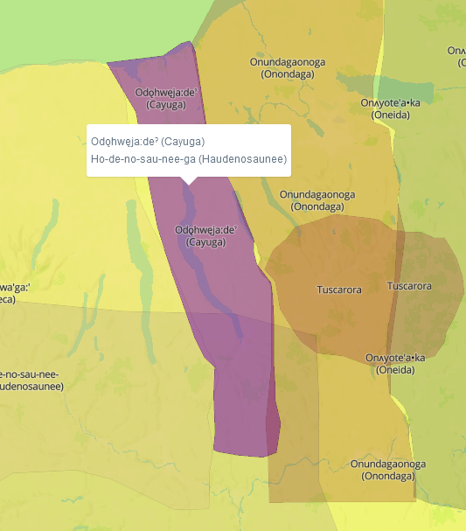
Land Acknowledgement
Cornell University is located on the traditional homelands of the Gayogo̱hó꞉nǫ' (the Cayuga Nation CCSS-RS@cornell.eduon). The Gayogo̱hó꞉nǫ' are members of the Haudenosaunee Confederacy, an alliance of six sovereign Nations with a historic and contemporary presence on this land. The Confederacy precedes the establishment of Cornell University, New York state, and the United States of America. We acknowledge the painful history of Gayogo̱hó꞉nǫ' dispossession and honor the ongoing connection of Gayogo̱hó꞉nǫ' people, past and present, to these lands and waters.
- American Indian & Indigenous Studies Program (AIISP), Cornell University
Here for more on the history of Cornell’s violent, colonial formation, the movement to return native lands, and about the AIISP program at Cornell.

Slide 4
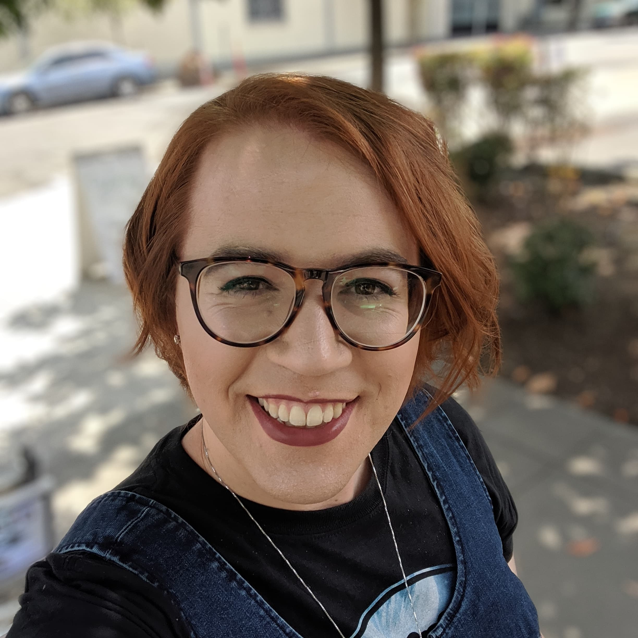
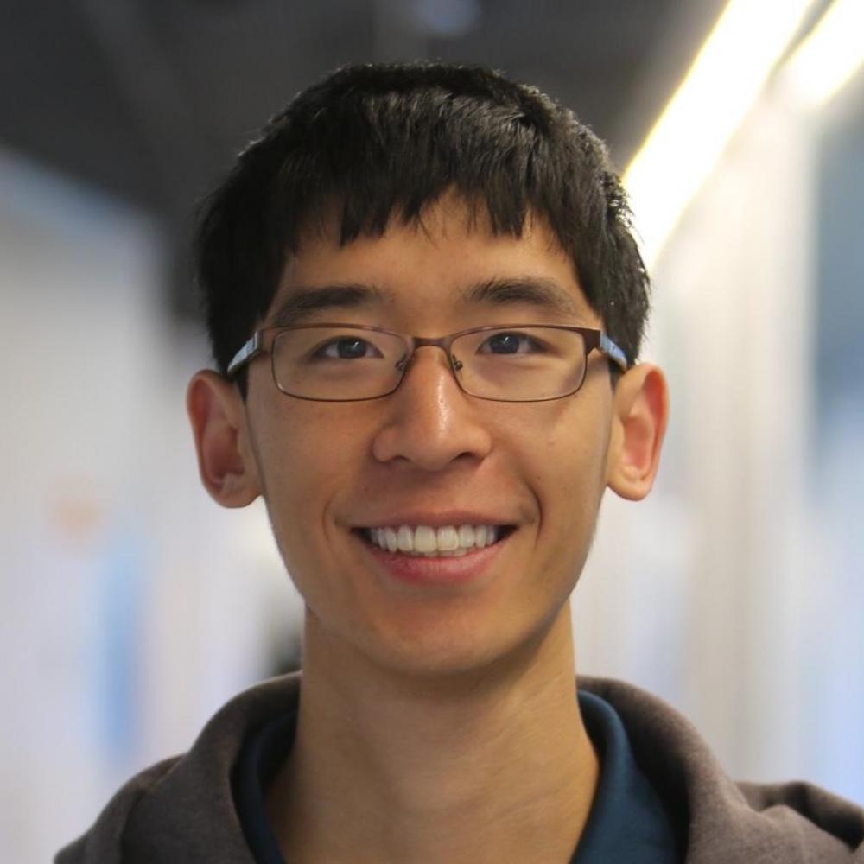
About the presenters:
Aspen Russell
PhD Student in Information Science
Norms in Online Communities
Hate speech, harassment, and misinformation
Has worked with: Reddit, Twitter, Facebook, arXiv, YouTube, and more.
Moonlights as a Dungeon Master
Jonathan Chang
PhD Candidate in Computer Science
Online content moderation
Making online interactions healthier
Has worked with: Reddit, Facebook, Wikipedia
Slowly grinding the new level cap in Pokémon Go

Slide 5
The API Workshop series
2/9: API Workshop 1
What are API’s and what can they do for you?
2/21: API Workshop 2
Practical Applications of the Twitter API
TBD: API Workshop 3
Research Design and Data Collection

Slide 6

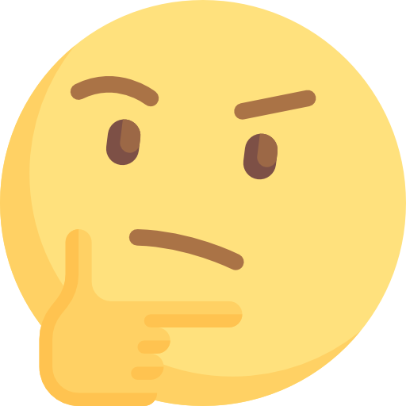

What is an api?
Packages
You
API
Platform
Menu
Order
Can we make that?
Do we have those ingredients?
Finished Meal

Slide 7





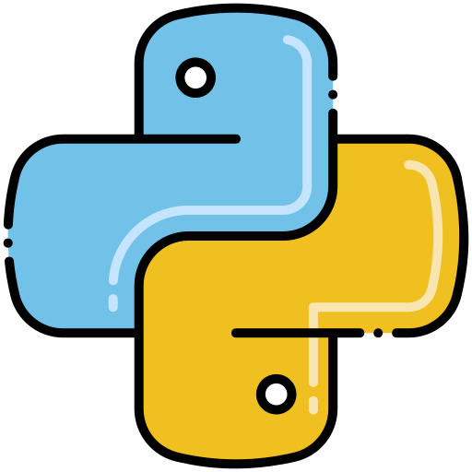
What’s out there? Programming Packages/Tools
RedditExtractoR
FORT API
academictwitteR
tubeR
PRAW: The Python Reddit API Wrapper
FORT API
tweepy
python-youtube

Slide 8

Twitter api v2 Overview
Full Archive Search (2006-Present)
Higher tweet cap (10 million)
More end points and filter options
Conversation IDs
Longer Queries
Annotations (detect nouns based on domains)

Slide 9

Goals for today
Get Tweets
Count Tweets
User Tweets
Conversation Threads
Geo-Tagged Tweets
User Look Up
Advanced Queries

Slide 10
Let’s Practice! (Breakout rooms)

Slide 11


Summary of learning objectives
Learned how to use a programming IDE (Rstudio or Python environment)
Used a programming package to interface with an API and get **DATA!**
Inspected the output data and discussed potential use cases for your work

Slide 12
Q&A (Thank you!)
Aspen Russell
Information Science PhD Student, Cornell University
aspen@infosci.cornell.edu
@InfoTisayentist on Twitter
Jonathan Chang
Computer Science PhD Candidate, Cornell University
jpchang@cs.cornell.edu
u/GradientDissent on Reddit

Slide 13
Attributions
Icons sourced from flaticon.com and from these artists: freepik, flaticon, becris, mynamepong, Yellowline, vidyavidz, Pixel perfect, and Prosymbols

